Slide 1

SERVERLESS IMAGE PROCESSING
Discover the power of AWS serverless image processing, an innovative solution that improves efficiency, scalability, and user satisfaction. With serverless image processing, you'll be able to process images faster and more reliably than ever before.

Slide 2


OUR AIM
Our aim was to create a serverless solution that automates image processing tasks, ensuring top-tier performance. Our solution offers automatic resizing, compression, and format conversion for user-uploaded images. By adopting serverless architecture, we achieved scalability, cost-effectiveness, and streamlined development.

Slide 3




How it Works
User Uploads Image
Lambda Function Processes Image
Processed Images Stored in S3
When a user uploads an image, AWS Lambda is triggered.
Our serverless function processes the image and stores the result in an S3 bucket.
Once processed, the images are stored in an S3 bucket for easy retrieval and distribution.

Slide 4

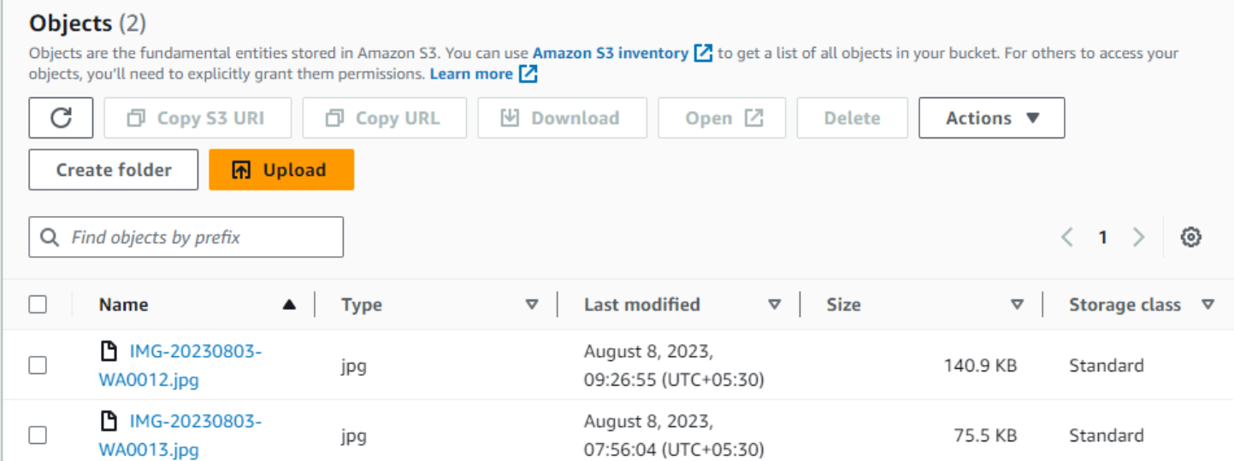
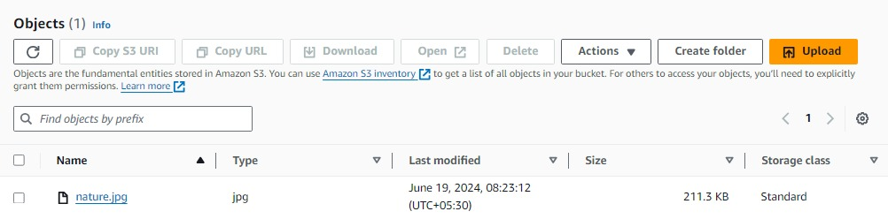
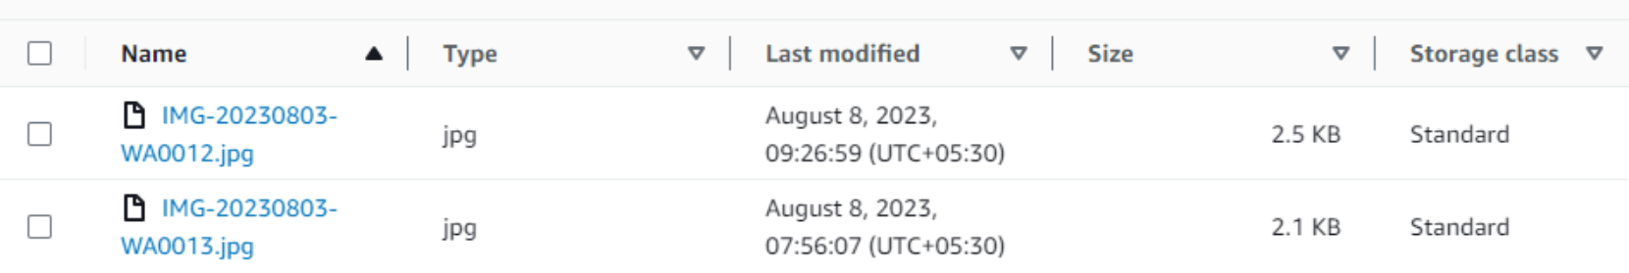

Before Processing
After Processing

Slide 5

The Benefits of Serverless Image Processing
1
Scalability
2
Reliability
3
Flexibility
Thanks to the auto-scaling features of AWS, businesses can handle any workload needed for image processing, no matter how big or small.
Our solution is built on AWS Lambda, a fully managed and resilient compute service.
Being serverless means our solution can handle any workload without worrying about server settings.

Slide 6

Examples of Image Processing Use Cases
eCommerce
Media and Entertainment
Healthcare
Enhance product images by adjusting colors, brightness and contrast in order to highlight product details and improve marketing strategy.
Image processing can help in medical diagnoses by analyses of medical images such as X-rays and CT scans, detecting specific medical disorders, tumors or other abnormal changes.
Use image processing to help recognize faces, objects, and scenes, which can enable dynamic features and enhanced user engagement.

Slide 7

Improved User Satisfaction
1
Better User Experience
Our serverless image processing solution helps reduce downtime and improve overall user satisfaction, keeping your customers happy and engaged.
Improved Customer Loyalty
2
Our solution can help you build lasting relationships with customers by improving engagement with your brand and boosting customer satisfaction.
3
Increased Productivity
With our solution, businesses can focus on core activities rather than worrying about image processing, ultimately increasing productivity.

Slide 8

Conclusion and Key Takeaways
Serverless image processing is a cost-effective solution that can handle any workload, no matter how big or small.
It can improve user satisfaction and drive customer loyalty while reducing downtime and improving overall efficiency.
With image processing, businesses can create more engaging content and increase productivity, keeping pace with today's digital age.

